Slide 1
Deep Learning
Generated for: Introduction to CNNs, Convolution Operation, Pooling Layers, CNN Architecture Example, Applications of CNNs
Notes:
Welcome to the Deep Learning presentation covering multiple topics. Today we'll explore: Introduction to CNNs, Convolution Operation, Pooling Layers, CNN Architecture Example, Applications of CNNs.

Slide 2

Introduction to CNNs - Introduction
Convolutional Neural Networks (CNNs) for image processing
Inspired by biological neural networks and visual cortex
Use convolutional and pooling layers for feature extraction
Effective for image classification, object detection tasks
Applications in self-driving cars, facial recognition systems
CNNs learn spatial hierarchies of features from images
Typical architecture includes convolution, pooling, flatten layers
Activation functions like ReLU, sigmoid used for non-linearity
Backpropagation algorithm used for training CNNs
Notes:
When introducing CNNs, explain the biological inspiration behind their development and their primary application in image processing tasks. Provide examples of real-world applications such as self-driving cars and facial recognition systems. Emphasize the importance of convolutional and pooling layers in feature extraction and the role of activation functions in introducing non-linearity. Ask students to consider how CNNs can learn complex features from images and how backpropagation is used for training. Key takeaways include understanding the basic architecture of CNNs and their effectiveness in image classification and object detection tasks.

Slide 3
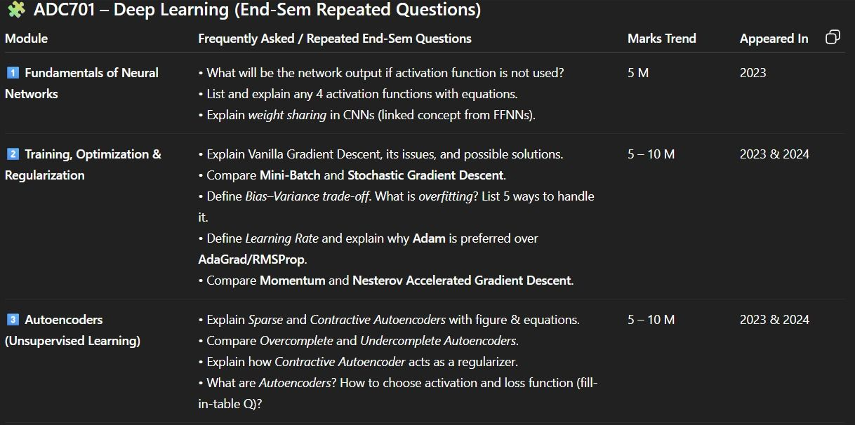
Introduction to CNNs - Fundamentals
CNNs utilize convolutional layers for image processing
Convolutional layers apply filters to small image regions
Filters detect edges, lines, and shapes in images
Pooling layers reduce spatial dimensions of feature maps
Fully connected layers classify images based on features
Activation functions introduce non-linearity to models
ReLU is a commonly used activation function
CNNs can be trained on large datasets like ImageNet
Transfer learning enables using pre-trained CNN models
y = σ(Wx + b) is a basic neural network equation
Notes:
When introducing the fundamentals of CNNs, emphasize the role of convolutional and pooling layers in image processing. Explain how filters detect basic features and how these features are used for classification. Provide examples of CNN applications, such as image classification and object detection. Discuss the importance of activation functions and the concept of transfer learning. Ask students to consider how CNNs can be applied to real-world problems, such as medical image analysis or self-driving cars. Key takeaways include understanding the basic architecture of CNNs and their ability to learn complex patterns in data.

Slide 4
Introduction to CNNs - Introduction
Convolutional Neural Networks (CNNs) are deep learning models
Inspired by human visual cortex structure and function
Used for image and video processing tasks
CNNs learn features from raw data automatically
Consist of convolutional and pooling layers
Activation functions introduce non-linearity
Optimized using backpropagation and stochastic gradient
Image classification is a primary application
Object detection and segmentation are also common
Notes:
When introducing CNNs, emphasize their inspiration from the human visual cortex and their ability to learn features automatically. Provide examples of image classification tasks, such as recognizing objects in pictures. Explain the basic architecture, including convolutional and pooling layers, and introduce key concepts like activation functions and backpropagation. Ask students to consider how CNNs can be applied to real-world problems, such as self-driving cars or medical image analysis. Key takeaways include understanding the basics of CNN architecture and their applications in computer vision.

Slide 5
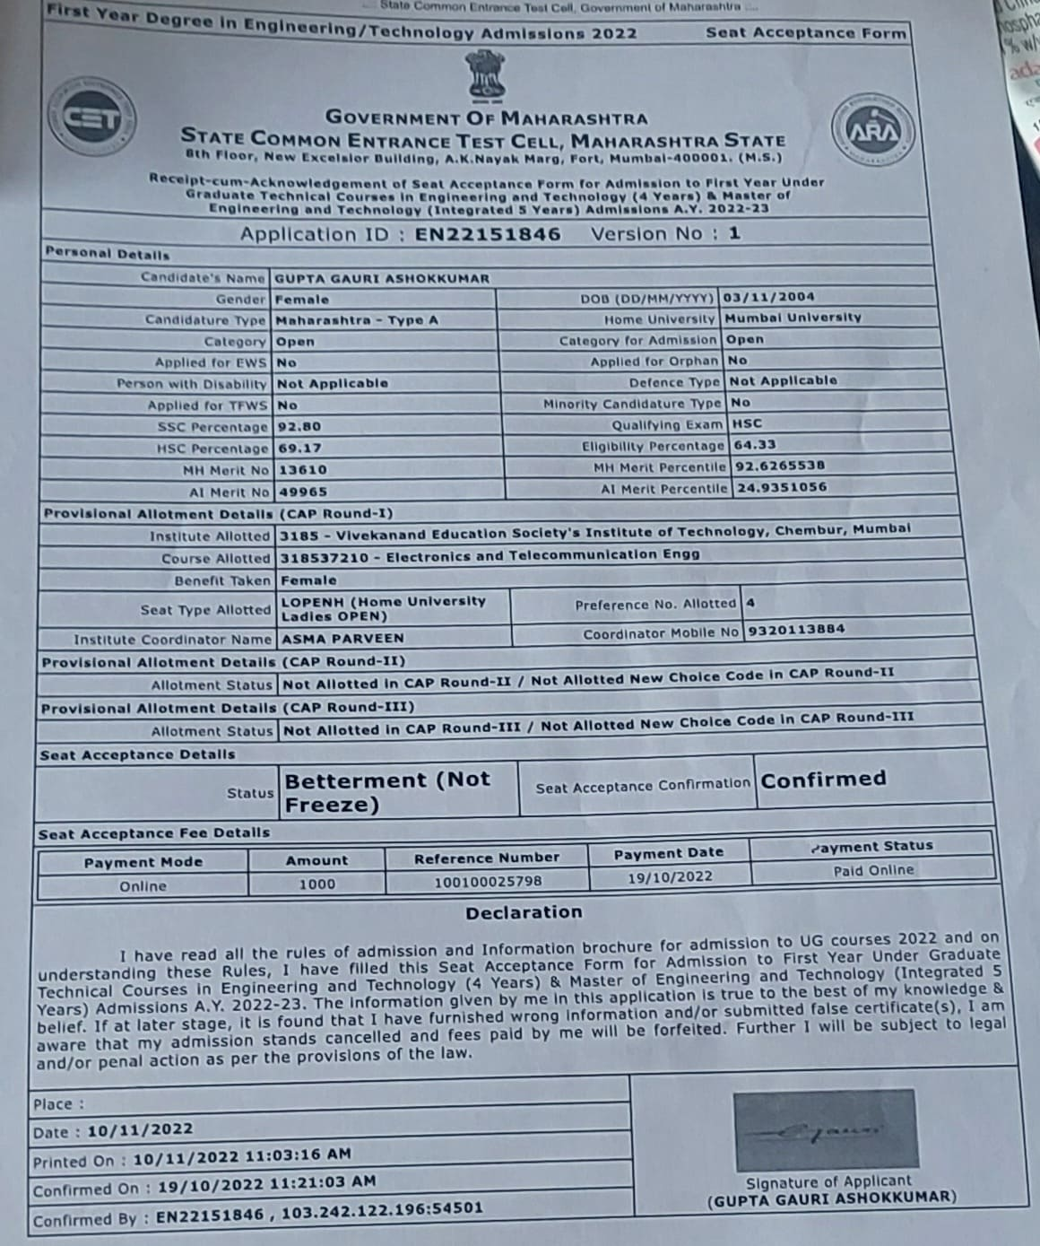
Convolution Operation - Introduction
Convolution operation combines images with filters
Extracts local features from small image regions
Used in image processing and deep learning
Enables spatial hierarchy of features
Robust to small transformations and distortions
Key component of convolutional neural networks
Applies filters to input data spatially
Preserves spatial relationships between data
Improves model performance and efficiency
Fundamental for computer vision tasks
Notes:
When introducing the convolution operation, emphasize its role in extracting local features from images and its application in deep learning, particularly in convolutional neural networks. Explain how it enables the model to be robust to small transformations and distortions. Provide examples of its use in image processing and computer vision tasks, such as object detection and image classification. Ask students to consider how the convolution operation might be applied to other types of data, like audio or text. Key takeaways should include understanding the convolution operation's purpose, its benefits, and its widespread use in deep learning architectures.

Slide 6
Convolution Operation - Introduction
Convolution operation combines images with filters
Filters detect edges, lines, and shapes in images
Convolution preserves spatial relationships between pixels
Stride and padding control output spatial dimensions
Convolution operation is translationally equivariant
It is a key component of convolutional neural networks
Used for image classification, object detection, segmentation
Convolution reduces spatial dimensions, retains features
Helps in extracting low-level features from images
Enables neural networks to learn hierarchical representations
Notes:
When introducing the convolution operation, explain how it works by combining images with filters to detect edges and shapes. Provide examples of how stride and padding affect output spatial dimensions. Discuss the importance of translational equivariance in convolution operations. Give examples of applications such as image classification and object detection. Ask students to consider how convolution helps in extracting features from images and enables neural networks to learn hierarchical representations. Key takeaways include understanding the role of filters, stride, and padding in convolution operations.

Slide 7
Convolution Operation - Introduction
Convolution operation is a fundamental concept in deep learning
It involves sliding filters over input data to extract features
Convolutional neural networks use convolution operation extensively
Input data can be images, videos, or audio signals
Filters are small matrices that scan input data
Feature maps are generated by applying filters to input data
Convolution operation reduces spatial dimensions of data
It helps in extracting local patterns and features from data
Convolution operation is followed by pooling and activation
y = σ(w*x + b) is a simple equation for convolution
Notes:
When introducing the convolution operation, explain its importance in deep learning and its application in various fields such as image and speech recognition. Provide examples of how convolutional neural networks use this operation to extract features from input data. Ask students to think about how the size and number of filters can affect the output of the convolution operation. Emphasize the role of convolution in reducing spatial dimensions of data and extracting local patterns. Use visual aids to illustrate the process of convolution and feature map generation. Key takeaways should include the definition of convolution operation, its applications, and its importance in deep learning architectures.

Slide 8
Pooling Layers - Introduction
Reduce spatial dimensions of data with pooling layers
Downsample feature maps to decrease parameters
Helps prevent overfitting in deep neural networks
Improves translation invariance in images
Max pooling and average pooling are common types
Max pooling selects maximum value in each window
Average pooling calculates mean value in each window
Pooling layers are typically used after convolutional layers
Enhance robustness to small transformations in data
Used in image classification, object detection tasks
Notes:
When introducing pooling layers, explain the concept of downsampling and its benefits in reducing parameters and preventing overfitting. Provide examples of max pooling and average pooling, and discuss their differences. Emphasize the importance of pooling layers in image classification and object detection tasks. Ask students to consider how pooling layers contribute to translation invariance and robustness to small transformations in data. Key takeaways include understanding the role of pooling layers in deep neural networks and their applications in computer vision tasks.

Slide 9
Pooling Layers - Introduction
Reducing spatial dimensions of data using pooling layers
Downsampling feature maps to retain key information
Helping prevent overfitting in deep neural networks
Pool size and stride determine output dimensions
Max pooling extracts maximum value from each region
Average pooling calculates mean value from each region
Min pooling finds minimum value in each region
Pooling layers are typically applied after convolutional layers
Improving translation invariance in convolutional neural networks
Enhancing robustness to small transformations
Notes:
When introducing pooling layers, explain that they are a crucial component in deep neural networks, helping to reduce the spatial dimensions of data while retaining key information. Provide examples of max, average, and min pooling, and discuss how pool size and stride impact output dimensions. Emphasize the role of pooling layers in preventing overfitting and improving translation invariance. Ask students to consider how pooling layers contribute to the robustness of convolutional neural networks, and provide examples of applications where pooling layers are particularly useful, such as image classification and object detection.

Slide 10
Pooling Layers - Introduction
Reduces spatial dimensions of data, retaining key features.
Helps prevent overfitting by reducing parameters.
Downsamples data, decreasing computational cost.
Max pooling extracts maximum value from regions.
Average pooling extracts average value from regions.
Global pooling reduces data to single value.
Used in convolutional neural networks (CNNs).
Improves translation invariance of models.
Enhances robustness to small transformations.
Supports real-time image processing applications.
Notes:
When introducing pooling layers, explain their purpose in reducing data dimensions while preserving critical features. Provide examples of max and average pooling, highlighting their differences. Discuss how global pooling can be used for tasks like image classification. Emphasize the role of pooling layers in preventing overfitting and improving model robustness. Ask students to consider how pooling layers contribute to the efficiency and effectiveness of convolutional neural networks in real-world applications, such as image recognition and object detection.

Slide 11
CNN Architecture Example - Introduction
Convolutional Neural Networks (CNNs) for image classification
CNNs utilize convolutional and pooling layers
LeNet-5: early CNN architecture example
AlexNet: large-scale CNN with deep layers
VGGNet: CNN with small convolutional filters
ResNet: residual learning for deep CNNs
CNNs apply y = σ(Wx + b) activation function
Image processing with CNNs is efficient
CNNs have various applications in computer vision
Deep learning frameworks support CNN implementation
Notes:
When introducing the CNN architecture example, explain the basic components of a CNN, such as convolutional and pooling layers. Provide examples of well-known CNN architectures like LeNet-5, AlexNet, VGGNet, and ResNet. Discuss the importance of activation functions like σ(Wx + b) in CNNs. Ask students to consider the applications of CNNs in image classification and computer vision. Key takeaways include understanding the basic CNN architecture and its various applications in deep learning.

Slide 12
CNN Architecture Example - Introduction
Convolutional Neural Networks (CNNs) for image classification
Image processing using convolutional and pooling layers
Feature extraction through convolution and activation functions
LeNet-5: early CNN architecture example for digit recognition
AlexNet: large-scale CNN for ImageNet classification
VGGNet: deep CNN with small convolutional filters
ResNet: residual learning for deep CNNs
Batch normalization for stable training
ReLU activation for non-linear transformations
y = σ(Wx + b) for neural network equations
Notes:
Introduce the concept of CNN architecture, explaining its application in image classification and feature extraction. Discuss the evolution of CNNs, from early models like LeNet-5 to more complex ones like AlexNet, VGGNet, and ResNet. Emphasize the importance of convolutional and pooling layers, activation functions, and batch normalization. Use the equation y = σ(Wx + b) to illustrate a simple neural network equation. Ask students to consider the advantages and limitations of each architecture, and how they can be applied to real-world problems. Key takeaways include understanding the basic components of a CNN and their role in image processing.

Slide 13
CNN Architecture Example - Applications
Image classification with convolutional layers
Object detection using YOLO and SSD
Segmentation with U-Net architecture
Image generation with GANs and CNNs
Facial recognition with deep CNNs
Medical imaging analysis with CNNs
Autonomous vehicles with CNN-based perception
Robotics and control with CNN-based vision
Surveillance and security with CNNs
y = σ(Wx + b) for activation functions
Notes:
When discussing the applications of CNN architecture, highlight the versatility and wide range of uses, from image classification to autonomous vehicles. Provide examples of real-world applications, such as self-driving cars using CNNs for object detection. Ask students to consider the benefits and limitations of using CNNs in different fields. Key takeaways include the ability to apply CNNs to various domains and the importance of understanding the underlying architecture and its components.

Slide 14
Applications of CNNs - Introduction
Convolutional Neural Networks for image classification
Object detection using CNNs and YOLO algorithm
Image segmentation with CNNs and U-Net architecture
CNNs for natural language processing and text analysis
Applications in self-driving cars and robotics
Medical imaging analysis using CNNs and deep learning
Facial recognition and security systems using CNNs
CNNs for recommender systems and predictive modeling
Real-time object tracking using CNNs and Kalman filter
Notes:
When introducing the applications of CNNs, explain how they have revolutionized image and video processing. Provide examples of self-driving cars using object detection and facial recognition in security systems. Ask students to think about potential applications in their own fields of interest. Key takeaways should include understanding the versatility of CNNs and their potential to solve complex problems in various domains.

Slide 15
Applications of CNNs - Introduction
Image classification with CNNs achieves high accuracy
Object detection in images and videos is a key application
Segmentation of images for medical diagnosis purposes
CNNs used in self-driving cars for scene understanding
Facial recognition systems rely on CNNs for identification
Image generation and style transfer using CNNs
CNNs applied in natural language processing tasks
Medical image analysis for disease diagnosis and treatment
Surveillance systems utilizing CNNs for anomaly detection
Robotics and autonomous systems using CNNs for navigation
Notes:
When introducing the applications of CNNs, emphasize the versatility of these networks across various domains. Provide examples such as how CNNs are used in medical imaging for tumor detection, in self-driving cars for pedestrian detection, and in facial recognition systems for security purposes. Ask students to consider the ethical implications of these applications and how they can contribute to society. Key takeaways should include understanding the breadth of CNN applications and their potential to revolutionize multiple fields.

Slide 16
Applications of CNNs - Computer Vision
Image classification using CNNs for object detection
Face recognition systems with deep learning
Scene understanding and image segmentation
Object localization with bounding boxes
Image generation using Generative Adversarial Networks
Medical image analysis for disease diagnosis
Image denoising and super-resolution techniques
Autonomous vehicles with CNN-based vision
Surveillance systems with real-time object detection
Notes:
When teaching this topic, emphasize the impact of CNNs on computer vision tasks. Provide examples of real-world applications, such as self-driving cars and medical diagnosis. Ask students to consider the limitations and challenges of these applications, and discuss potential solutions. Key takeaways include understanding the role of CNNs in image classification, object detection, and image segmentation, as well as their applications in various industries.

